Slide 1

Business Intelligence Report
Pizza Sales
Performance Analysis
SQL-Driven Executive Report
Data-Backed Strategic Insights
Revenue & Demand Analytics
Prepared for Senior Management
February 2026

Slide 2
Navigation
Executive Overview
01
Key Business KPIs
04
Customer Behavior
Performance dashboard with core metrics: orders, revenue, and operational efficiency
Ordering patterns, size preferences, and traffic timing analysis
05
Strategic Recommendations
02
Revenue Analysis
Data-driven action plans for marketing, inventory, and growth optimization
Growth trends, cumulative revenue patterns, and financial stability indicators
Key Insight
03
Product Performance
This analysis leverages 21,350 transactional orders to deliver actionable business intelligence for strategic decision-making.
Top-selling pizzas, category distribution, and pricing insights

Slide 3
Analysis Overview
Executive Summary
Analysis Objectives
Key Findings
This comprehensive SQL-driven analysis evaluates end-to-end pizza sales performance using transactional order data. The objective is to identify revenue drivers, customer ordering behavior, high-performing products, and time-based demand trends to support data-driven business decisions.
Strong Revenue Stability
Consistent cumulative growth without major volatility
Balanced Product Portfolio
All categories contribute 23-27% of total revenue
By leveraging 21,350+ orders and $817,860 in revenue, we uncover actionable insights for operational optimization and strategic growth.
Clear Demand Patterns
Lunch and dinner peaks drive 70%+ of daily orders
Premium Pricing Power
High-priced pizzas contribute significantly to AOV
Data Source
Methodology
Business Impact
SQL-based transactional database with daily order records, product details, pricing, and timing information
KPI tracking, trend analysis, category segmentation, and behavioral pattern recognition
The business demonstrates predictable sales behavior, diversified revenue streams, and strong operational consistency—positioning it well for scalable growth.

Slide 4
Performance Dashboard
Key Business KPIs
Total Orders Placed
Total Revenue Generated
Avg. Daily Orders
Time Span
21,350
$817,860
~138
Full Period
Complete order history
Gross sales revenue
Pizzas per day
Daily transactional data
Revenue Performance Metrics
Performance Highlights
Stable daily operations
Average Order Value
Revenue per Pizza
Consistent revenue flow
$38.31
$18.20
Strong order frequency
Total Pizzas Sold
Pizzas per Order
Data Quality
44,928
2.10
100% transactional coverage
Complete order tracking
Real-time data accuracy

Slide 5
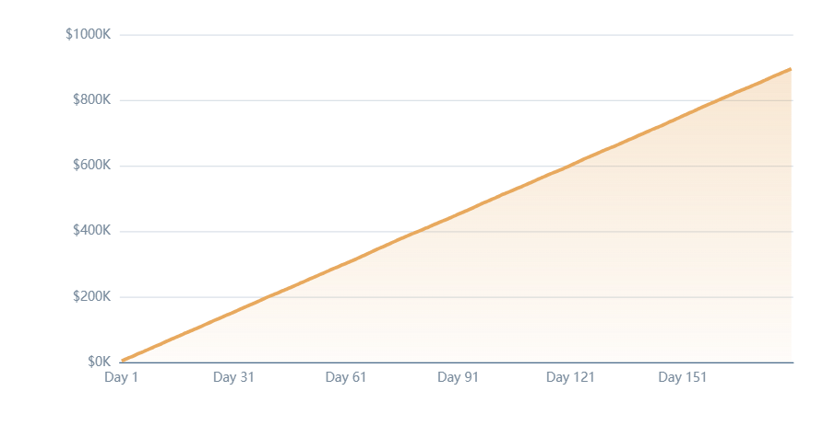
Financial Performance
Revenue Analysis & Growth Trends
Cumulative Revenue Growth Over Time
Total Revenue
$817,860
Revenue is consistently generated across time, showing stable daily sales performance with cumulative growth.
Revenue Stability Indicators
Steady Growth Pattern
Revenue increases consistently without major drops
Low Volatility
No extreme fluctuations indicate predictable business
Sustainable Model
Healthy cumulative trajectory supports scaling

Slide 6
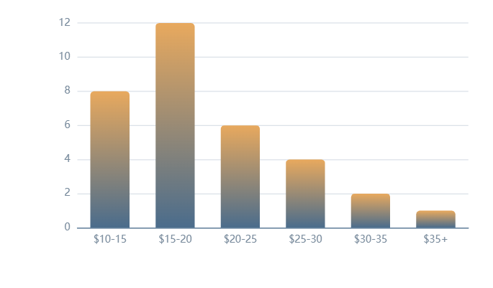
Product Strategy
Product Portfolio & Pricing Insights
Highest Priced Pizza
Pricing Distribution Analysis
The Greek Pizza
$35.95
per unit
Premium pizzas contribute significantly to revenue per order, even if volumes are lower. This indicates strong pricing power and customer willingness to pay for quality.
Category-Wise Pizza Variety
Each category (Classic, Veggie, Chicken, Supreme) has a well-distributed number of pizza types, indicating a balanced menu strategy catering to diverse customer preferences.
Classic
Supreme
Traditional favorites
Loaded toppings
Veggie
Chicken
Price Range
Avg. Price
Plant-based options
Premium protein
$12.95 - $35.95
Across all pizzas
Wide spectrum
$18.20

Slide 7
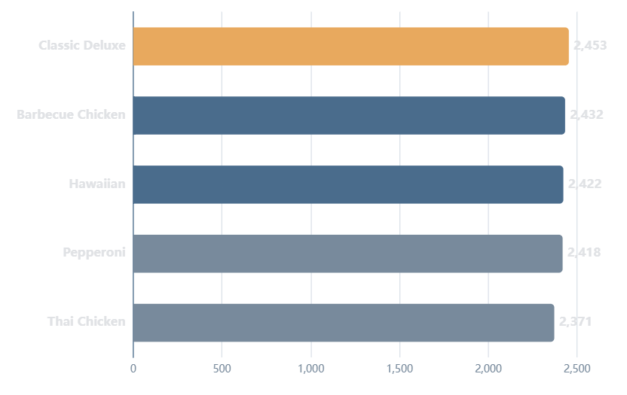
Demand Analysis
Top-Selling Pizzas by Quantity
Top 5 Most Ordered Pizza Types
Core Demand Drivers
These pizzas represent core demand drivers and should be prioritized in promotions and inventory planning.
1
Classic Deluxe
2,453 units
2
Barbecue Chicken
2,432 units
3
Hawaiian
2,422 units
Strategic Implications
Classic category shows strongest volume
Chicken pizzas rank high in both volume and revenue
Top 5 pizzas account for ~27% of total volume
Ensure consistent availability for demand fulfillment

Slide 8
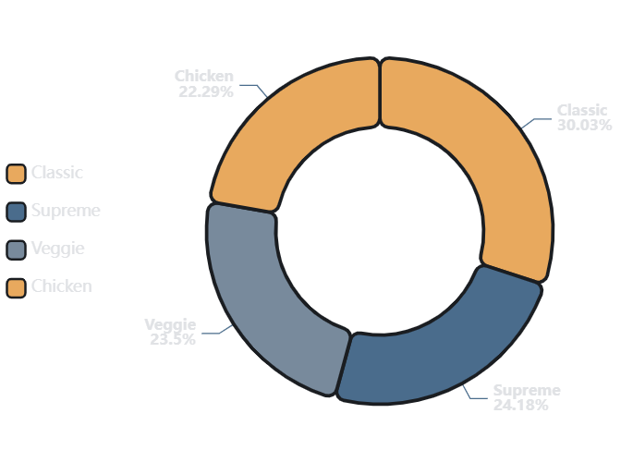
Portfolio Analysis
Category-Wise Demand Distribution
Quantity Sold by Category
Classic
Supreme
14,888
11,987
pizzas sold
pizzas sold
33.1% of total
26.7% of total
Veggie
Chicken
11,649
11,050
pizzas sold
pizzas sold
25.9% of total
24.6% of total
Portfolio Balance
Classic pizzas lead overall demand, but Supreme, Veggie, and Chicken categories show balanced performance with only 8.5% variance between highest and lowest. This diversification reduces risk.

Slide 9
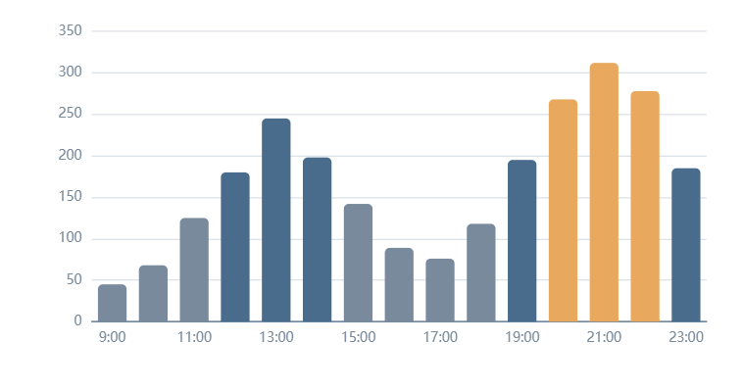
Customer Insights
Customer Ordering Behavior & Traffic Patterns
Orders by Hour of Day
Most Common Pizza Size
Large
Dominates orders
Preference for group/family consumption
Higher average order value (AOV)
Drives revenue per transaction
Strategic Opportunities
Time-Based Promotions
Target off-peak hours (2-5PM) with special offers
Staffing Optimization
Align workforce with lunch/dinner peaks
Lunch Peak
Dinner Peak
Off-Peak
Inventory Planning
12PM
6-8PM
2-5PM
Prep ingredients before peak hours

Slide 10
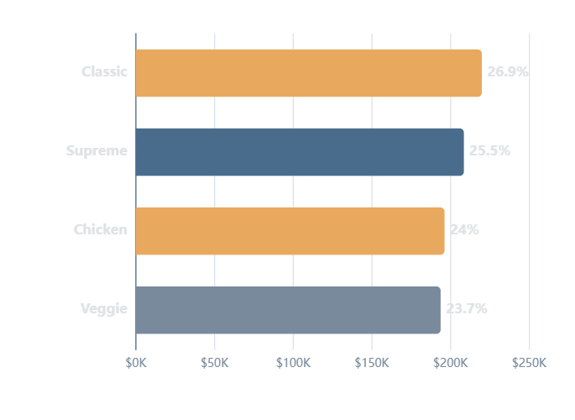
Revenue Performance
Revenue Leaders & Category Contribution
Top 3 Revenue-Generating Pizzas
Revenue Contribution by Category
1
Thai Chicken Pizza
$43,434
Premium specialty
2
Barbecue Chicken
$42,768
Customer favorite
3
California Chicken
$41,409
West coast style
Key Insight: Chicken-based pizzas are the strongest revenue contributors, demonstrating premium pricing acceptance.
Revenue Concentration
Top 3 pizzas generate $127,611 (15.6% of total revenue), indicating strong product-market fit for premium chicken offerings.

Slide 11
Action Plan
Strategic Insights & Recommendations
Marketing Focus
Time-Based Promotions
Focus marketing efforts on high-revenue Chicken pizzas. Thai Chicken, Barbecue Chicken, and California Chicken generate $127K+ combined—prioritize these in campaigns.
Use time-based promotions during off-peak hours (2-5PM) to drive traffic. Offer lunch combos (11AM-2PM) and happy hour deals (3-5PM) to smooth demand curves.
Inventory Management
Loyalty & Combos
Maintain inventory strength for Classic category due to highest demand (14,888 units). Ensure consistent availability of Classic Deluxe, Hawaiian, and Pepperoni pizzas.
Leverage top-selling pizzas for combo meals and loyalty programs. Bundle Classic Deluxe with drinks/desserts to increase basket size and customer retention.
Premium Upselling
Operational Optimization
Introduce premium upselling strategies using high-priced pizzas like The Greek Pizza ($35.95). Train staff to recommend premium options to increase AOV.
Align staffing with lunch (12PM) and dinner (6-8PM) peaks. Reduce labor during 2-5PM slow periods and cross-train staff for flexibility.

Slide 12

Final Insights
Conclusion &
Next Steps
This SQL-driven analysis provides a 360-degree view of sales performance, uncovering strong revenue stability, balanced product demand, and clear growth opportunities.
Revenue Stability
Balanced Portfolio
Growth Ready
$817,860 with consistent growth trajectory
All categories contribute 23-27% of revenue
Data-backed strategies for scaling
The business is well-positioned to scale using data-backed operational and marketing strategies. With predictable sales behavior, diversified revenue streams, and strong operational consistency, the foundation is set for sustainable growth.
Pizza Sales Business Performance Analysis
Analysis Complete
SQL-Driven Executive Report | February 2026
Ready for implementation

